Slide 1
Docker Masterclass: 40 Practical Demos
Kalyan Reddy Daida

Slide 2
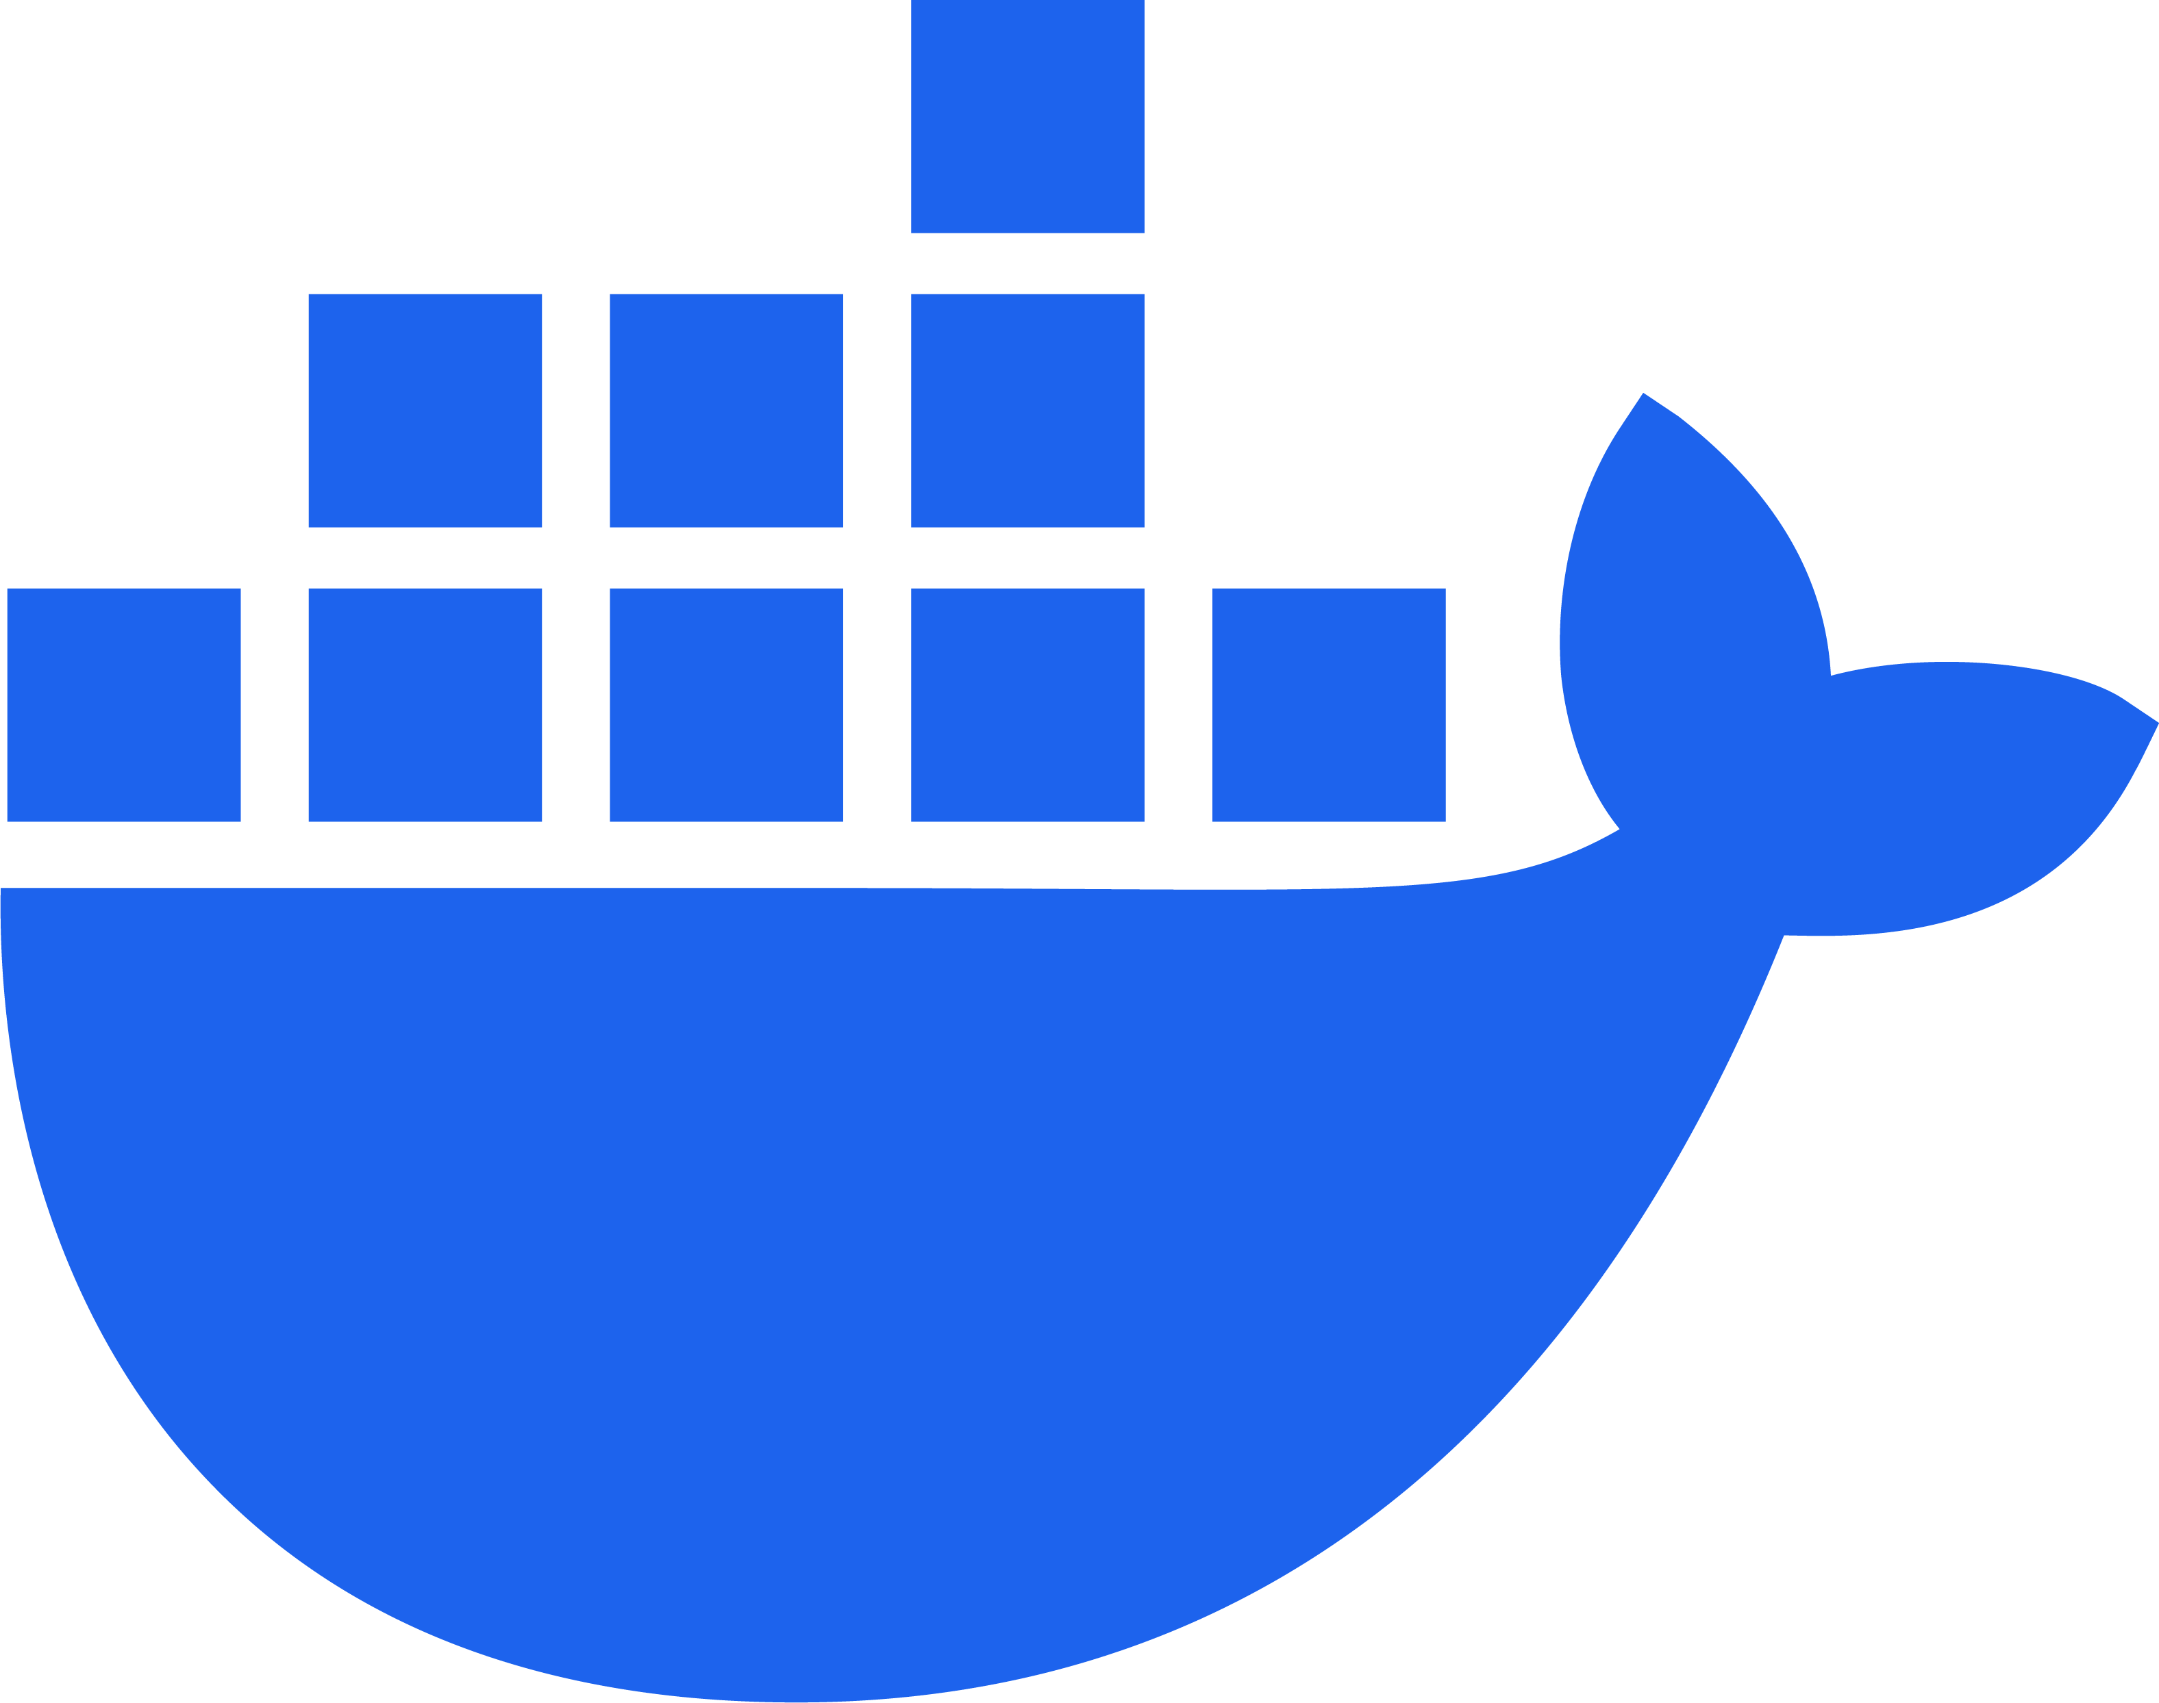
Docker Masterclass
Docker Introduction
40
Practical Demos
06
Dockerfile ADD
(Fetch from URL)
Why Docker?
00
07
Dockerfile ARG
Docker Terminology
Daemon, Client, Image, Container, Hub
00
08
Dockerfile RUN, EXPOSE
Docker Basics
09
Dockerfile ENV, WORKDIR
Docker Install
01
10
Dockerfile CMD
Pull and Run Docker Images from Docker Hub
02
11
Dockerfile ENTRYPOINT
Build a Docker Image and Push to Docker Hub
03
Docker
12
Dockerfile HEALTHCHECK
Step by Step GitHub Documentation
13
Dockerfile USER
Dockerfile Instructions
Dockerfile LABELS
04
Docker Ports
Dockerfile ADD vs COPY
05
14
Docker Ports (-p, -P flags)

Slide 3
Docker Masterclass
Docker Storage
40
Practical Demos
Multi-Container Application
Docker Volume Basics
15
23
Deploy Multi-container app with Docker Commands
Docker Volume
Mount to a Container
16
Docker Compose
Docker Volume
Populate Data in Volumes
17
24
Docker Compose Volumes, ENV
Docker Volume
Mount volume sub-directory
18
25
Docker Compose
Named Volume with metadata
Docker Bind Mount Basics
19
26
Docker Compose
Multi-container App
Docker Bind Mount
Read Only Mounts
20
27
Docker Compose
DEPLOY (Scale Replicas, 3-Tier)
Docker
Docker Volume vs Bind Mounts (non-empty dir)
21
Step by Step GitHub Documentation
28
Docker Compose
NETWORKS (Frontend, Backend)
Docker tmpfs mount
22
29
Docker Compose
HEALTHCHECKS
30
Docker Compose
STARTUP ORDER

Slide 4
Docker Masterclass
Docker Compose
40
Practical Demos
Docker Build
Docker Compose
PROFILES
31
37
Docker Build
BuildKit: Custom Builder
Docker Compose
LINKS
32
38
Docker Build
Multi-platform Docker Images
Docker Compose
NETWORK ALIASES
33
39
Docker Build Cloud
Use Remote Cloud Builder
Docker Compose
BUILD
34
40
Docker Build
Multi-stage Builds
Docker Compose
Develop Watch (SYNC + RESTART)
35
Docker Compose
Develop Watch (SYNC + REBUILD)
36
Docker
Step by Step GitHub Documentation

Slide 5
GitHub Repository
Repository Used For | Repository URL
Course Main Repository with step-by-step documentation | https://github.com/stacksimplify/docker-in-a-weekend

Slide 6
Docker
Why Docker?

Slide 7

What problems we have with Traditional Infra?
Traditional Approach
Installation & Configuration
Time consuming
Need to perform install/configs on every server and every environment (dev, qa, staging, production)
Compatibility & Dependency
Need to keep resolving issues related to libraries and dependencies
Inconsistencies across Environments
Very hard to track changes across Dev/QA/Staging and Prod environments and they end up with inconsistencies
Operational Support
Need more resources to handle operational issues on day to day basis
Server Support (hardware, software)
Patching releases
Developer Environments
When a new developer joins the team, time it takes to provision his development environment in traditional approach is time taking.
Webservers
AppServers
Databases
Libraries
Dependencies
Operating System
Hardware Infrastructure

Slide 8
Physical Machines
Virtual Machines
Virtual Machine
Virtual Machine
Webservers
AppServers
Databases
Webservers
AppServers
Databases
Webservers
AppServers
Databases
Libs
Deps
Libs
Deps
Operating System
Operating System
Libraries
Dependencies
Hypervisor
Operating System
Hardware Infrastructure
Hardware Infrastructure

Slide 9
Physical Machines with Docker
Container
Container
Container
Webservers
AppServers
Databases
Libs
Deps
Libs
Deps
Libs
Deps
Docker
Operating System
Hardware Infrastructure

Slide 10
Virtual Machines with Docker
Virtual Machine
Virtual Machine
Container
Container
Container
Container
Container
Container
Webservers
AppServers
Databases
Webservers
AppServers
Databases
Libs
Deps
Libs
Deps
Libs
Deps
Libs
Deps
Libs
Deps
Libs
Deps
Docker
Docker
Operating System
Operating System
Hypervisor
Hardware Infrastructure

Slide 11
Advantages of using Docker
Flexible
Complex apps can be easily containerized.
Lightweight
Containers use fewer resources than virtual machines
Portable
You can build locally, deploy to the cloud, and run anywhere.
Why Containers ?
Loosely Coupled
Replace or upgrade containers without affecting others.
Scalable
Easily scale containers across data centers.
Secure
Containers provide isolation without extra setup.

Slide 12
Docker
Architecture

Slide 13
Docker - Terminology
Docker Daemon
The Docker daemon (dockerd) listens for Docker API requests and manages Docker objects such as images, containers, networks, and volumes.
Docker Client
Docker client can be present on either Docker Host or any other machine (local desktop).
The Docker client (docker) is the primary way that many Docker users interact with Docker.
When you use commands such as docker run, the client sends these commands to dockerd (Docker Daemon), which carries them out.
The docker command uses the Docker API.
The Docker client can communicate with more than one daemon.
Docker Client (Optional)
Docker Daemon
Docker Host

Slide 14
Docker - Terminology
Docker Images
An image is a read-only template with instructions for creating a Docker container.
Often, an image is based on another image, with some additional customization.
For example, we want to add custom configs in nginx, then we take base nginx image and modify as per our need. We will know more when we go to demo-3 (Build Docker Image) section
Docker Containers
A container is a runnable instance of an image.
We can create, start, stop, move, or delete a container using the Docker API or CLI.
We can connect a container to one or more networks, attach storage to it, or even create a new image based on its current state.
When a container is removed, any changes to its state that are not stored in persistent storage disappear.
Docker Client (Optional)
Docker Daemon
Image-1
Container-11
Image-2
Container-21
Images
Containers
Docker Host

Slide 15
Docker - Terminology
1
Pull Docker Image from Docker Hub
Docker Registry or Docker Hub
A Docker registry stores Docker images.
Docker Hub is a public registry that anyone can use, and Docker is configured to look for images on Docker Hub by default.
We can even run our own private registry.
When we use the docker pull or docker run commands, the required images are pulled from our configured registry.
When we use the docker push command, our image is pushed to our configured registry.
stacksimplify/mynginx:v1
stacksimplify/mynginx:v2
stacksimplify/mynginx:v3
stacksimplify/mynginx:v4
Docker Registry (Docker Hub)
Docker Daemon
Run Docker Containers
2
container-1
stacksimplify/mynginx:v1
container-2
Images
Containers
Docker Host
docker pull stacksimplify/mynginx:v1
docker run --name container-1 -p 81:80 -d stacksimplify/mynginx:v1
docker run --name container-2 -p 82:80 -d stacksimplify/mynginx:v1
Docker Client (My Desktop or Docker Host)

Slide 16
Demo-01
Docker Install Docker

Slide 17
Install Docker
Install Docker Desktop
Sign Up to Docker Hub

Slide 18
Demo-02
Docker Pull Docker Image from Docker Hub and Run

Slide 19
Docker Command - Basics
1
Pull Docker Image from Docker Hub
Pull Docker Image from Docker Hub
docker pull stacksimplify/mynginx:v1
Run Docker Container
docker run --name myapp1 -p 8080:80 -d stacksimplify/mynginx:v1
Connect to Docker containers
docker exec -it myapp1 /bin/sh
docker exec -it myapp1 hostname
Start and Stop Docker Containers
docker stop myapp1
docker start myapp1
Remove Docker Containers
docker rm myapp1
Remove Docker Images
docker rmi stacksimplify/mynginx:v1
stacksimplify/mynginx:v1
stacksimplify/mynginx:v2
stacksimplify/mynginx:v3
stacksimplify/mynginx:v4
Docker Registry (Docker Hub)
Docker Daemon
Run Docker Containers
2
container-1
stacksimplify/mynginx:v1
container-2
Images
Containers
1
docker pull stacksimplify/mynginx:v1
2
docker run --name container-1 -p 81:80 -d stacksimplify/mynginx:v1
Docker Desktop

Slide 20
Demo-03
Docker Build Docker Image and Push to Docker Hub

Slide 21
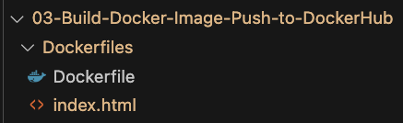
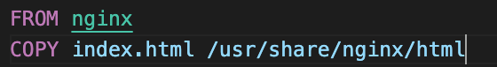
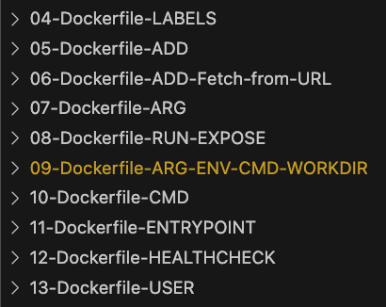
Dockerfile
Folder Structure
What is a Dockerfile ?
Simple text file that contains set of instructions to build a Docker Image
Automates the process of creating Docker Images by specifying steps which are called INSTRUCTIONS in Docker terminology
Example:
Install software
Copy files
Set environment variables
Run commands
Define entry point for your application (start application when container starts)
Dockerfile
10 Demos to master writing Dockerfiles

Slide 22
Build Docker Image and Push to Docker Hub
Build Docker Image
docker build -t mynginx-custom:v1 .
Run Docker Container
docker run --name mynginx1 -p 8090:80 -d mynginx-custom:v1
Tag Docker Image
docker tag mynginx-custom:v1 stacksimplify/mynginx-custom:v1
Push Docker Image to Docker Hub
docker push stacksimplify/mynginx-custom:v1
Search Docker Images in Docker Hub
docker search nginx
docker search --filter=stars=50 nginx
docker search --filter=is-official=true nginx
YOUR-DOCKER-ID/mynginx-custom:v1
Docker Registry (Docker Hub)
Docker Daemon
Build Docker Image
Run Container
1
2
mynginx-custom:v1
container-1
4
YOUR-DOCKER-ID/mynginx-custom:v1
Push Docker Image
to Docker Hub
Images
3
Containers
Tag Docker Image
Docker Desktop

Slide 23
Demo-04
Dockerfile LABEL Instruction

Slide 24
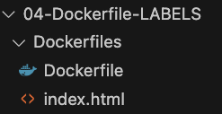
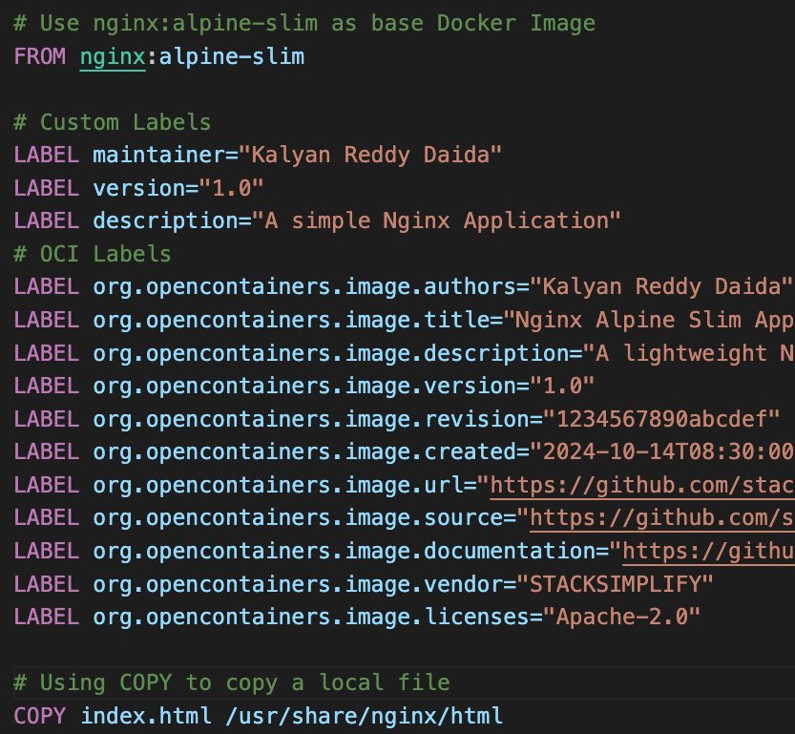
Dockerfile - LABEL Instruction
Folder Structure
What is LABEL instruction in Dockerfile?
Adds metadata to an Image
An Image can have more than one label
Labels included in the base image are inherited by your image
If a label already exists but with a different value, the most-recently-applied value overrides any previously-set value
How to view Image labels?
We can use docker image inspect command
docker image inspect --format='{{json .Config.Labels}}' myimage
Dockerfile

Slide 25
Demo-05
Dockerfile ADD vs COPY Instructions

Slide 26
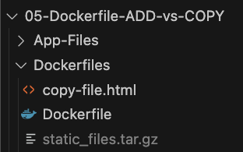
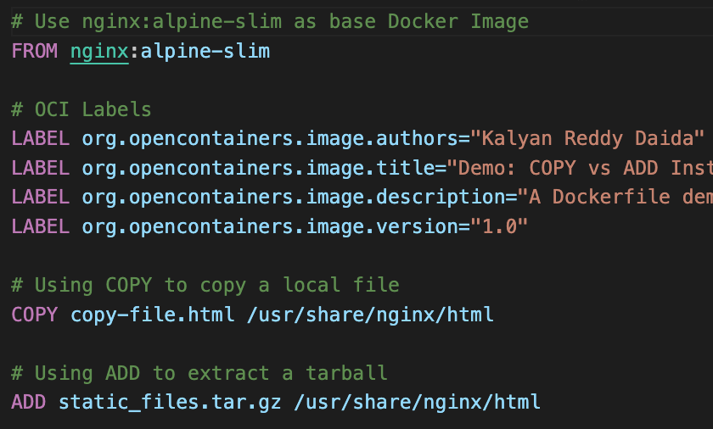
Dockerfile - COPY vs ADD
Folder Structure
What is COPY instruction in Dockerfile?
The COPY instruction copies new files or directories from <src> and adds them to the filesystem of the image at the path <dest>
Files and directories can be copied from the
build context
build stage
named context
an image
What is ADD instruction in Dockerfile?
The ADD instruction copies new files or directories from <src> and adds them to the filesystem of the image at the path <dest>
Files and directories can be copied from the
build context
a remote URL
a Git repository
Dockerfile

Slide 27
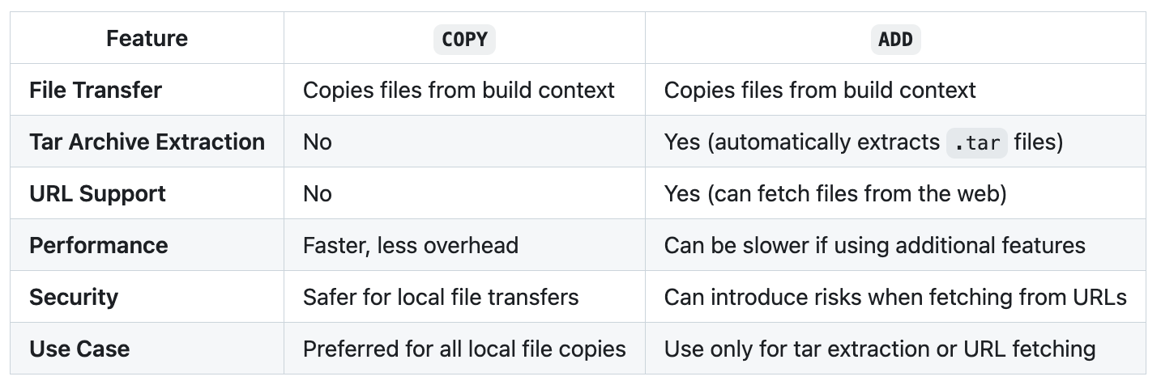
Dockerfile - COPY vs ADD

Slide 28
Demo-06
Dockerfile ADD - Fetch from URL (GitHub)

Slide 29
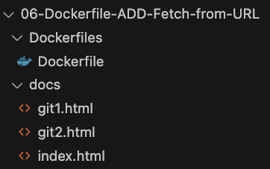
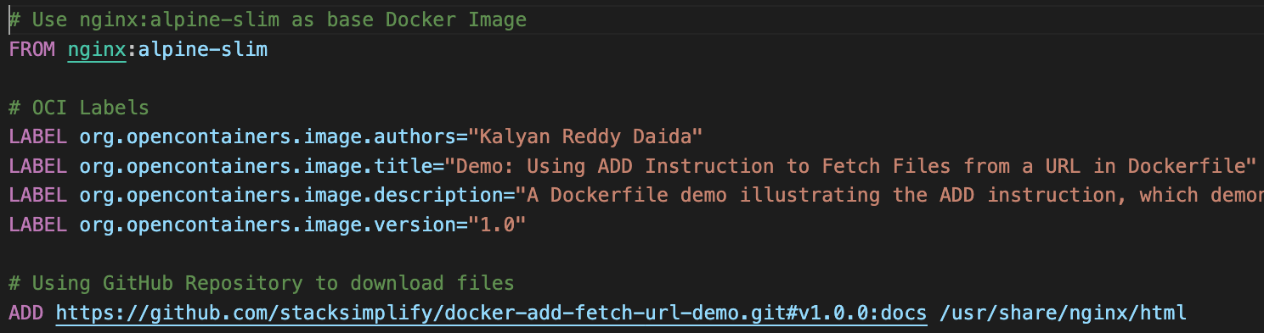
Dockerfile - ADD Instruction
Folder Structure
ADD: Fetch from URL Demo
To add files from a remote location, you can specify a
URL: https://example.com/archive.zip
Git Release: https://github.com/stacksimplify/docker-add-fetch-url-demo.git#v1.0.0:docs
Dockerfile

Slide 30
Demo-07
Dockerfile ARG Instruction

Slide 31
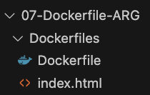
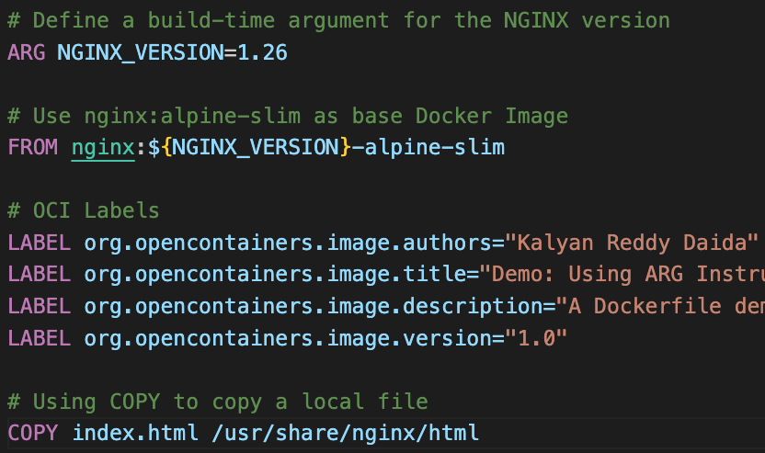
Dockerfile - ARG Instruction
Folder Structure
What is ARG instruction in Dockerfile?
Defines a variable that users can pass at build-time to the builder with
Docker Command: docker build
Using the flag: --build-arg <varname>=<value>
We can define one or more ARG instructions
We can define default values for ARG instructions in Dockerfile
ARG NGINX_VERSION=1.26
An ARG variable definition comes into effect from the line on which it is defined
ENV variables always overrides ARG variables (if same variable defined in both places)
Dockerfile

Slide 32
Demo-08
Dockerfile RUN and EXPOSE Instructions

Slide 33
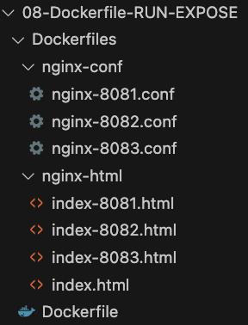
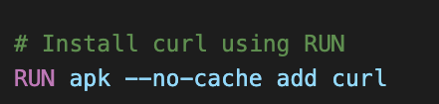
Dockerfile - RUN Instruction
Folder Structure
What is RUN instruction in Dockerfile?
The RUN instruction will execute any commands to create a new layer on top of the current image
The added layer is used in the next step in the Dockerfile
Cache Invalidation for RUN Instructions
Problem: Isn’t invalidated automatically during next build
Example: RUN apt-get dist-upgrade –y will be reused in next build
Solution: The cache for RUN instructions can be invalidated by using the --no-cache flag
Example: docker build --no-cache
Sample RUN Instruction from Dockerfile

Slide 34
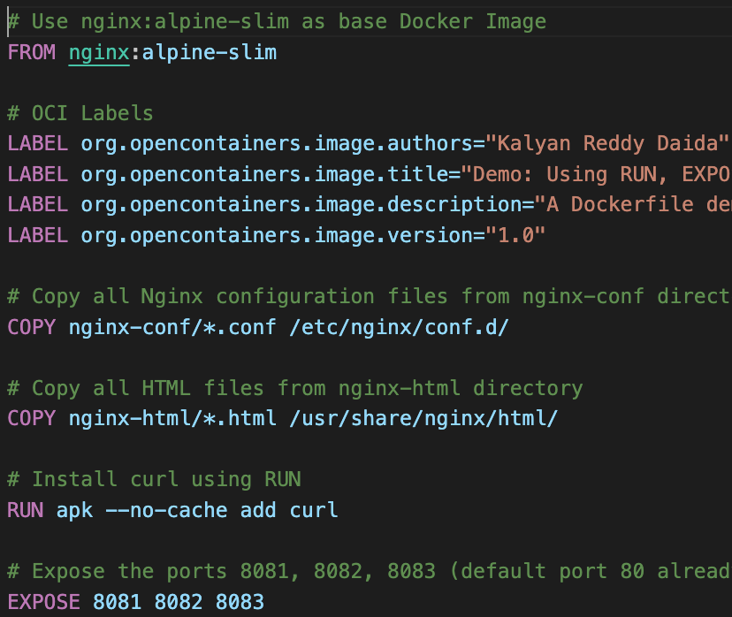
Dockerfile - EXPOSE Instruction
What is EXPOSE instruction in Dockerfile?
Informs Docker that the container listens on the specified network ports at runtime
You can specify whether the port listens on TCP or UDP, and the default is TCP if you don't specify a protocol.
EXPOSE 80: defaults to TCP, exposes on TCP
EXPOSE 80/udp: Exposes on UDP
EXPOSE 80/tcp: Exposes on TCP
Dockerfile

Slide 35
Demo-09
Dockerfile ENV, ARG, CMD, WORKDIR Instructions

Slide 36
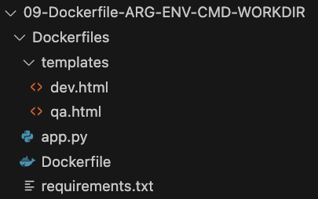
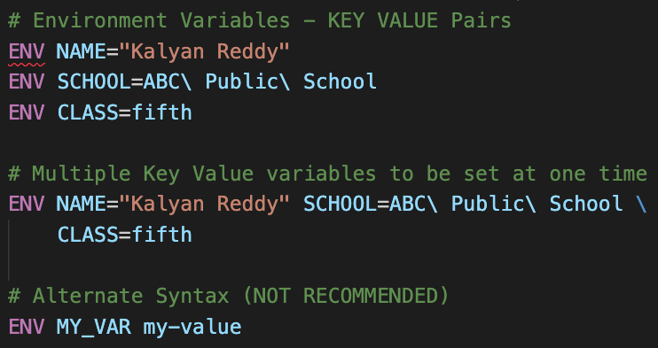
Dockerfile - ENV Instruction
Folder Structure
What is ENV instruction in Dockerfile?
ENV sets the environment variables
What is the key difference between ENV and ARG ?
ENV: ENV is persisted in the final image and will be available in container when it is run from this image
ARG: ARG is not persisted in the final image, so no scope of using that value in the container when it is run from this image.
How to define ENV in Dockerfile?

Slide 37
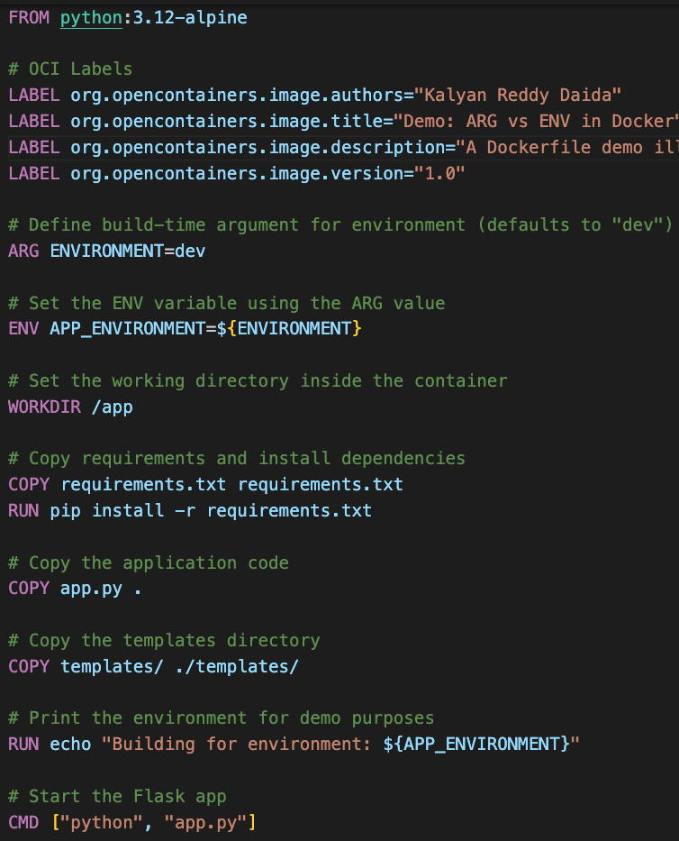
Dockerfile - WORKDIR Instruction
Dockerfile
What is WORKDIR instruction in Dockerfile?
Sets the working directory for any RUN, CMD, ENTRYPOINT, COPY and ADD instructions that follow it in the Dockerfile.
The WORKDIR instruction can be used multiple times in a Dockerfile
If WORKDIR not specified, the default working directory is “/”
If we are using the base image “FROM python”, WORKDIR likely to be set by the base image
Important Note: To avoid unintended operations in unknown directories, it's best practice to set your WORKDIR explicitly.

Slide 38
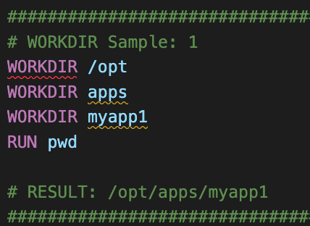
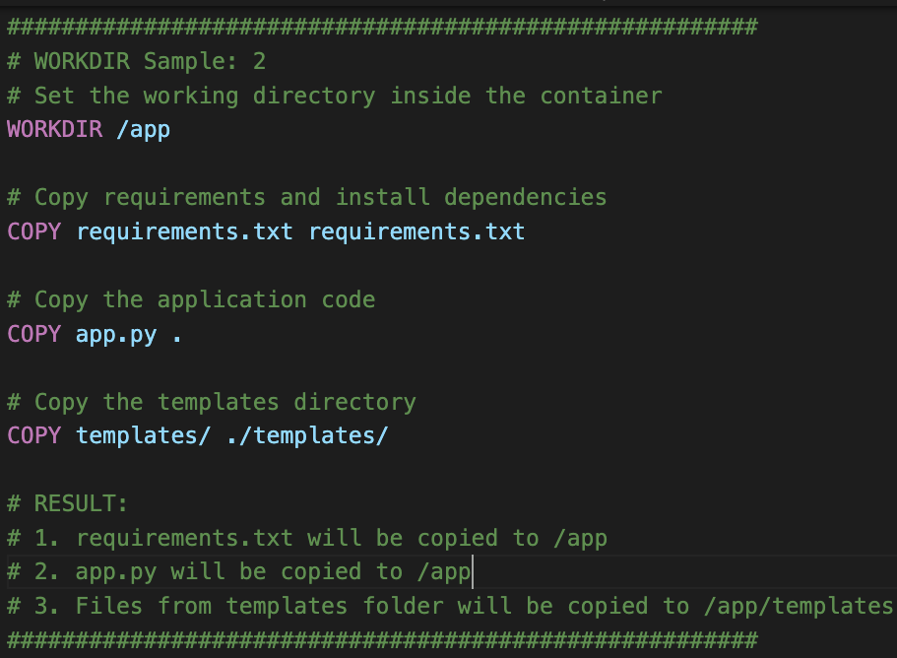
Dockerfile - WORKDIR Instruction
WORKDIR Sample-1
WORKDIR Sample-2

Slide 39
Dockerfile - CMD Instruction
Dockerfile
What is CMD instruction in Dockerfile?
Defines the command to run when starting a container from the image
Only one CMD instruction is allowed per Dockerfile, if there are multiple, only the last one is used
Used to set default commands or parameters for the container
Syntax Options
CMD ["executable","param1","param2"]
CMD ["param1","param2"]
CMD command param1 param2

Slide 40
Demo-10
Dockerfile CMD Instruction
(Override with docker run Command)

Slide 41
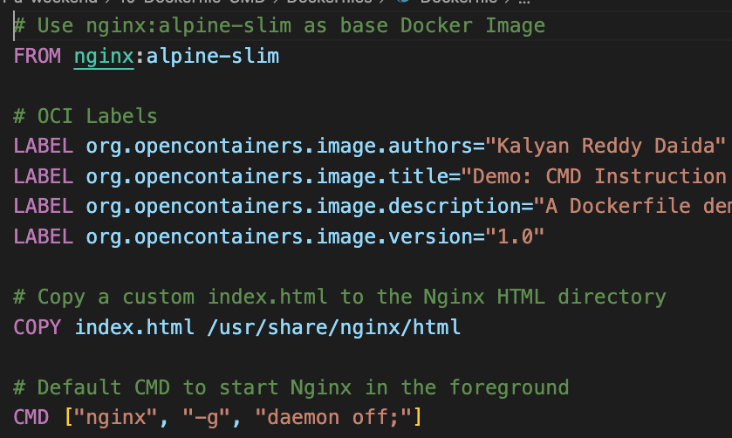
Dockerfile - CMD Instruction
What is CMD instruction in Dockerfile?
Defines the command to run when starting a container from the image
Only one CMD instruction is allowed per Dockerfile, if there are multiple, only the last one is used
Used to set default commands or parameters for the container
Syntax Options
CMD ["executable","param1","param2"]
CMD ["param1","param2"]
CMD command param1 param2
Dockerfile
It can be overridden by specifying a different command during “docker run”

Slide 42
Demo-11
Dockerfile ENTRYPOINT Instruction

Slide 43
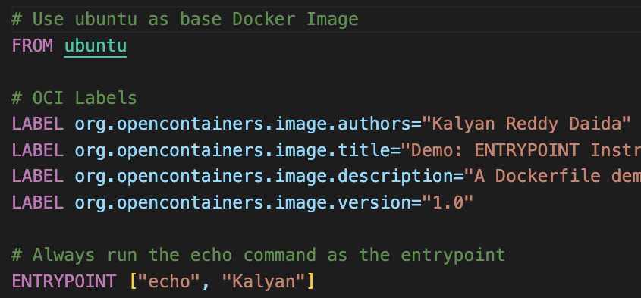
Dockerfile - ENTRYPOINT Instruction
What is ENTRYPOINT instruction in Dockerfile?
An ENTRYPOINT allows you to configure a container that will run as an executable.
It is useful for setting up a container that runs a specific command or application.
SYNTAX
ENTRYPOINT ["executable", "param1", "param2"]
Dockerfile

Slide 44
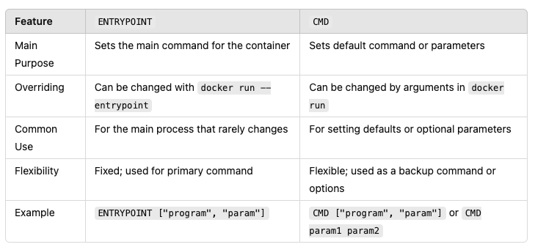
Dockerfile: ENTRYPOINT vs CMD Instructions

Slide 45
Demo-12
Dockerfile HEALTHCHECK Instruction

Slide 46
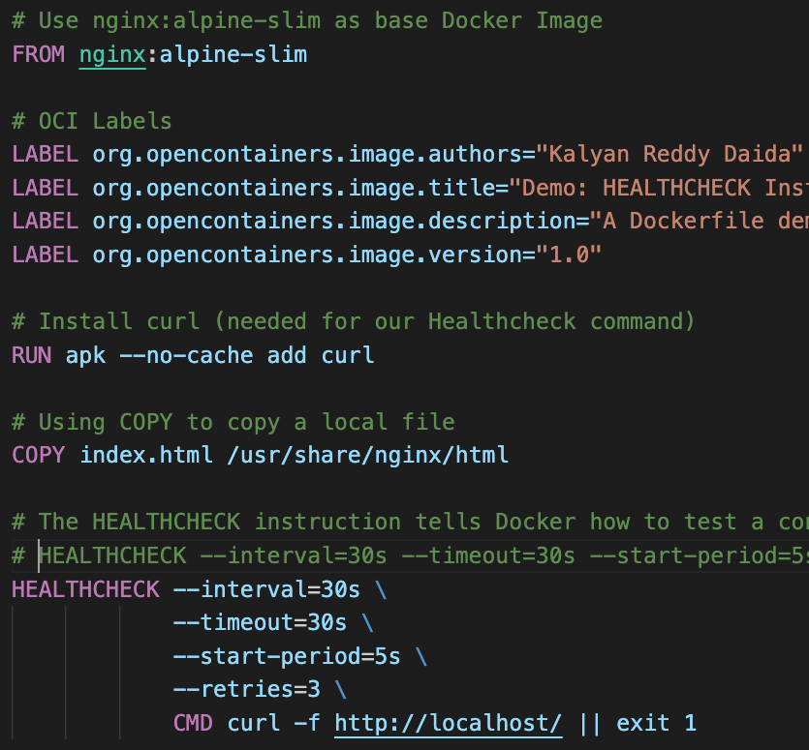
Dockerfile - HEALTHCHECK Instruction
Dockerfile
What is HEALTHCHECK instruction in Dockerfile?
It tells Docker how to test a container to check that it's still working
This can detect cases such as a
web server stuck in a loop, unable to handle new connections even if still running
Health Status in Docker
Starting: Initially during the start
Healthy: When health check passes
Unhealthy: Marked unhealthy after consecutive health check failures

Slide 47
Dockerfile - HEALTHCHECK Instruction
Dockerfile
HEALTH CHECK SYNTAX
HEALTHCHECK [OPTIONS] CMD command
check container health by running a command inside the container
HEALTHCHECK --interval=30s --timeout=30s --start-period=5s --start-interval=5s --retries=3 CMD curl -f http://localhost/ || exit 1
HEALTHCHECK NONE
Disable any health check inherited from the base image

Slide 48
Demo-13
Dockerfile USER Instruction

Slide 49
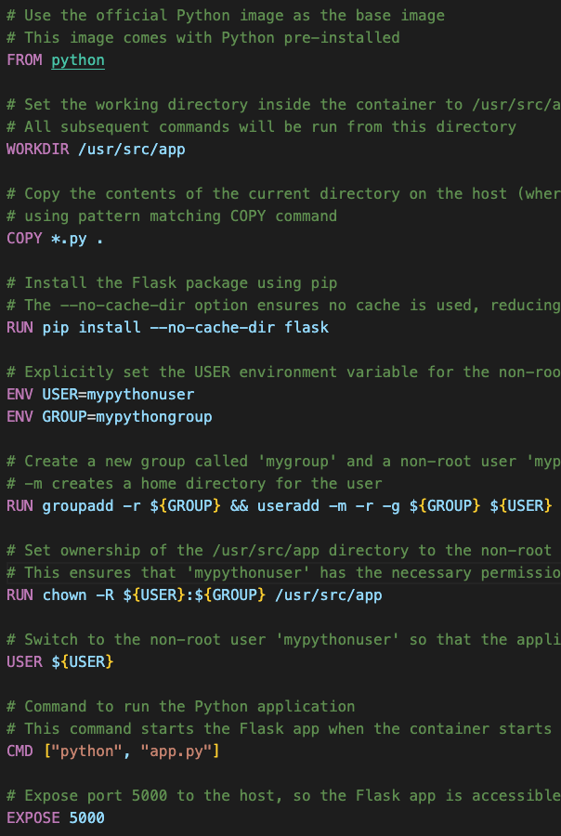
Dockerfile - USER Instruction
Dockerfile
What is USER instruction in Dockerfile?
Sets the default user (or UID) and group (or GID) for the rest of the stage
Applies to RUN, ENTRYPOINT, and CMD commands
Important Note: If a group is set, only that group applies; other groups are ignored.
User Context from Security perspective
Running containers as a non-root user enhances security by minimizing the potential impact of vulnerabilities.
By specifying a user with limited permissions, the attack surface is reduced, making it harder for malicious actors to exploit the container.

Slide 50
Demo-14
Docker Ports Single and Multi-Ports

Slide 51
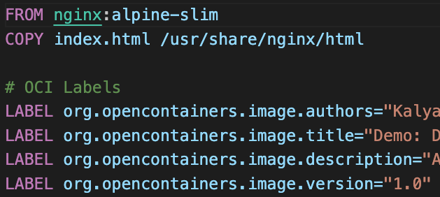
Docker Ports
Dockerfile
Understanding Port Mapping with -p Flag
Map specific host ports to container ports using -p host_port:container_port
Allows direct access to container services via designated host ports.
Example:
docker run --name my-ports-demo1 -p 8090:80 -d demo14-docker-singleport:v1 maps host port 8090 to container port 80
Publishing All Exposed Ports with -P Flag
Use -P to publish all exposed ports to random high-numbered host ports.
Ideal for multi-port applications where manual mapping is cumbersome.
Ports are dynamically assigned and can be viewed with docker ps.
Example:
docker run --name my-ports-demo3 -P -d demo14-docker-multiport:v1

Slide 52
Demo-15
Docker Storage Volume Basics

Slide 53
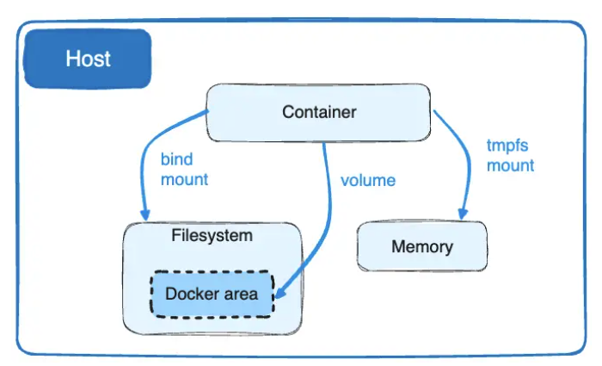
Docker Volumes vs Bind Mounts
Volumes: Volumes are the preferred mechanism for persisting data by Docker containers
Bind Mounts: Bind mounts are dependent on the directory structure and OS of the host machine, volumes are completely managed by Docker.
Volumes have several advantages over bind mounts
Volumes are easier to back up or migrate than bind mounts.
You can manage volumes using Docker CLI commands or the Docker API.
Volume vs Bind Mount

Slide 54
Docker Volumes vs Bind Mounts
Volumes work on both Linux and Windows containers.
Volumes can be more safely shared among multiple containers.
Volume drivers let you store volumes on remote hosts or cloud providers, encrypt the contents of volumes, or add other functionality.
New volumes can have their content pre-populated by a container.
Volumes on Docker Desktop have much higher performance than bind mounts from Mac and Windows hosts.
Volume vs Bind Mount

Slide 55
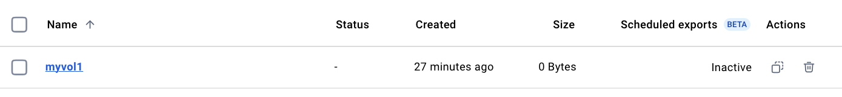
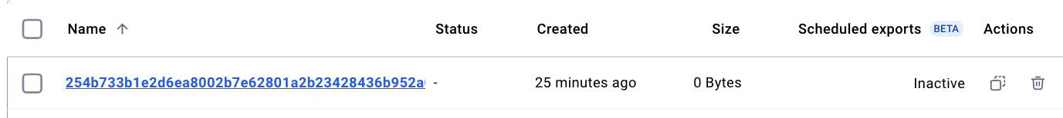
Docker Volume Types
Named Volumes
Create volume with a name
Command: docker volume create my-volume
Anonymous Volume
Create volume with dynamically generated name
Command: docker volume create

Slide 56
Demo-16
Docker Storage Volume Mount Options
(--mount vs -v)

Slide 57
Docker Volumes: --mount vs -v
Mounting Volumes with the --mount Flag
Utilize the newer --mount syntax for explicit volume mounting.
More verbose and explicit.
Better for complex scenarios requiring detailed configuration.
Provides clarity with key-value pairs.
Syntax:
--mount type=volume,source=volume_name,target=container_path.
Volume using --mount
docker run \
--name volume-demo1 \
-p 8090:80 \
--mount type=volume,source=myvol101,target=/myapps \
-d \
nginx:alpine-slim

Slide 58
Docker Volumes: --mount vs -v
Mounting Volumes with the -v Flag
Use the shorthand -v or --volume for quick volume mounts
Concise but can be ambiguous.
Doesn't support all options available with –mount
Preferred for simplicity and quick setups.
Syntax:
-v volume_name:container_path.
Volume using -v
docker run \
--name volume-demo2 \
-p 8091:80 \
-v myvol102:/myapps \
-d \
nginx:alpine-slim

Slide 59
Demo-17
Docker Storage - Volumes 1. Populate Data in Docker Volumes using Containers
2. Mount Volumes with Read-Only option

Slide 60
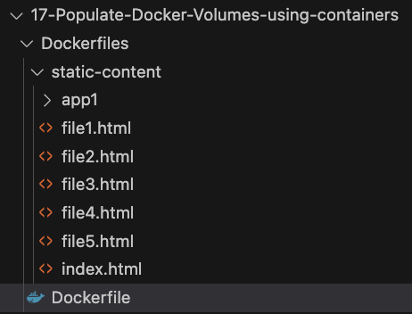
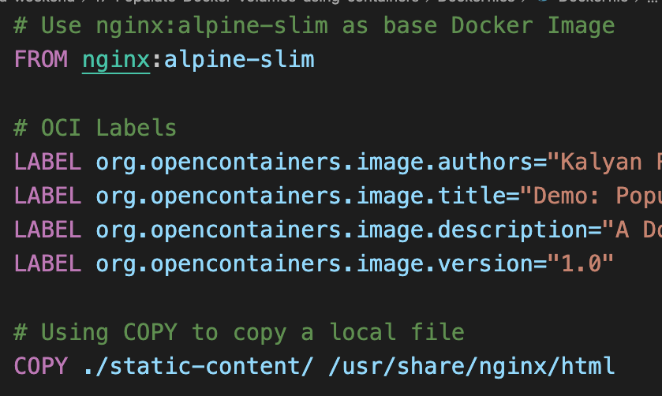
Docker Volumes: Populate Data using Containers
Folder Structure
What happens to data present in Docker Container (default data from Docker Image) when a volume is mounted at same path ?
Docker Image named (abc:v1): Contains some content at /usr/share/nginx/html
When a container is created with new volume mounted at same path (/usr/share/nginx/html):
The static content from the Docker container (created from image) is copied to the volume automatically
No data loss; the volume contains the initial data from the image
This highlights benefit of using volumes for data persistence in Docker
Dockerfile

Slide 61
Docker Volumes: Mount Volume Read-Only
Volume using --mount: Read Write Access
--mount Flag with Read-Only Access
Prevents containers from modifying the volume's data.
Observation: Attempts to write to the volume within the container will fail.
Syntax
--mount source=volume_name,target=container_path,readonly
docker run \
--name volume-demo3 \
-p 8093:80 \
-v myvol103:/usr/share/nginx/html \
-d \
nginx:alpine-slim
Volume using --mount: Read Only Access
docker run \
--name volume-demo4 \
-p 8094:80 \
--mount source=myvol103,target=/usr/share/nginx/html,readonly \
-d \
nginx:alpine-slim

Slide 62
Docker Volumes: Mount Volume Read-Only
Volume using -v: Read Write Access
-v Flag with Read-Only Access
Alternative shorthand for read-only mounts.
Observation: Attempts to write to the volume within the container will fail.
Syntax
-v volume_name:container_path:ro
docker run \
--name volume-demo2 \
-p 8091:80 \
-v myvol102:/myapps \
-d \
nginx:alpine-slim
Volume using -v: Read Only Access
docker run \
--name volume-demo5 \
-p 8095:80 \
-v myvol103:/usr/share/nginx/html:ro \
-d \
nginx:alpine-slim

Slide 63
Demo-18
Docker Storage Mount a
Docker Volume Sub-directory

Slide 64
Docker Volumes: Mount a Subdirectory
Volume using --mount: volume-subpath Key
Mount a Subdirectory
Enables granular control over which parts of the volume are accessible to the container.
Useful for sharing specific data without exposing the entire volume content.
docker run \
--name volume-demo6 \
-p 8096:80 \
--mount type=volume,source=myvol103,target=/usr/share/nginx/html/app1,volume-subpath=app1 \
-d \
nginx:alpine-slim

Slide 65
Demo-19
Docker Storage
Bind Mounts

Slide 66
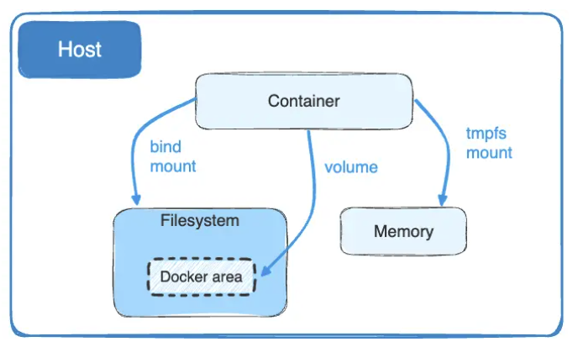
Docker Storage: Bind Mounts
Docker Bind Mounts
Bind Mounts
When you use a bind mount, a file or directory on the host machine is mounted into a container
Bind mounts have limited functionality compared to volumes
The file or directory is referenced by its absolute path on the host machine
The file or directory does not need to exist on the Docker host already
By contrast, when you use a volume, a new directory is created within Docker's storage directory on the host machine, and Docker manages that directory's contents
Docker Bind Mounts
docker run \
--name bind-demo1 \
-p 8091:80 \
--mount type=bind,source="$(pwd)"/static-content,target=/usr/share/nginx/html \
-d \
nginx:alpine-slim

Slide 67
Demo-20
Docker Storage Bind Mounts (Read-Only)

Slide 68
Docker Storage: Bind Mounts (Read-Only)
Docker Bind Mounts
Bind Mounts: Read-Only
Use bind mounts to securely share files and directories without allowing modifications from the container.
Ideal for serving static content or configurations that should not be altered by the container.
Docker Bind Mounts with -v flag
Docker Bind Mounts with --mount flag
docker run \
--name bind-demo4 \
-p 8094:80 \
-v "$(pwd)"/static-content:/usr/share/nginx/html:ro \
-d \
nginx:alpine-slim
docker run \
--name bind-demo3 \
-p 8093:80 \
--mount type=bind,source="$(pwd)"/static-content,target=/usr/share/nginx/html,readonly \
-d \
nginx:alpine-slim

Slide 69
Demo-21
Docker Storage Volume vs Bind Mount

Slide 70
Docker Storage: Volume vs Bind Mount
Feature | Docker Volumes | Docker Bind Mounts
Data Storage | Data is stored in Docker's special directories on the host. | Direct mapping of a host directory or file into the container's filesystem.

Slide 71
Docker Storage: Volume vs Bind Mount
Feature | Docker Volumes | Docker Bind Mounts
Data Storage | Data is stored in Docker's special directories on the host. | Direct mapping of a host directory or file into the container's filesystem.
Data Location | Stored in Docker's designated area (e.g., /var/lib/docker/volumes/) | Any directory or file on the host machine.

Slide 72
Docker Storage: Volume vs Bind Mount
Feature | Docker Volumes | Docker Bind Mounts
Data Storage | Data is stored in Docker's special directories on the host. | Direct mapping of a host directory or file into the container's filesystem.
Data Location | Stored in Docker's designated area (e.g., /var/lib/docker/volumes/) | Any directory or file on the host machine.
Data Persistence | Data persists even after the container is deleted; managed by Docker. | Data is tied directly to the host filesystem; changes affect both the host and container immediately.

Slide 73
Docker Storage: Volume vs Bind Mount
Feature | Docker Volumes | Docker Bind Mounts
Data Storage | Data is stored in Docker's special directories on the host. | Direct mapping of a host directory or file into the container's filesystem.
Data Location | Stored in Docker's designated area (e.g., /var/lib/docker/volumes/) | Any directory or file on the host machine.
Data Persistence | Data persists even after the container is deleted; managed by Docker. | Data is tied directly to the host filesystem; changes affect both the host and container immediately.
Effect on Container Data | Preserves Existing Data: When mounted to a non-empty container directory, existing container data is copied into the volume on first use. | Overrides Container Data: When mounted to a non-empty container directory, the host's data replaces the container's existing data.

Slide 74
Docker Storage: Volume vs Bind Mount
Feature | Docker Volumes | Docker Bind Mounts
Data Storage | Data is stored in Docker's special directories on the host. | Direct mapping of a host directory or file into the container's filesystem.
Data Location | Stored in Docker's designated area (e.g., /var/lib/docker/volumes/) | Any directory or file on the host machine.
Data Persistence | Data persists even after the container is deleted; managed by Docker. | Data is tied directly to the host filesystem; changes affect both the host and container immediately.
Effect on Container Data | Preserves Existing Data: When mounted to a non-empty container directory, existing container data is copied into the volume on first use. | Overrides Container Data: When mounted to a non-empty container directory, the host's data replaces the container's existing data.
Use Cases | - Sharing data between containers - Persisting data like databases - Production environments where data integrity is crucial | - Development environments needing live code changes - Testing configurations - Accessing host files from the container

Slide 75
Docker Storage: Volume vs Bind Mount
Feature | Docker Volumes | Docker Bind Mounts
Performance | Generally optimized by Docker for better performance and reliability. | Performance depends on the host's filesystem and may vary.

Slide 76
Docker Storage: Volume vs Bind Mount
Feature | Docker Volumes | Docker Bind Mounts
Performance | Generally optimized by Docker for better performance and reliability. | Performance depends on the host's filesystem and may vary.
Security | More secure; isolated from the host's filesystem and managed by Docker. | Less secure; grants the container direct access to the host's filesystem.

Slide 77
Demo-22
Docker Storage tmpfs Mount

Slide 78
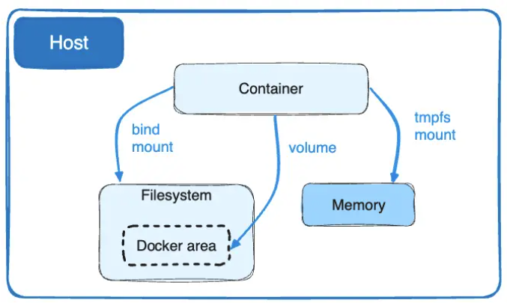
Docker Storage: tmpfs Mount
Docker tmpfs Mount
tmpfs Mounts:
Volumes and bind mounts let you share files between the host machine and container so that you can persist data even after the container is stopped.
tmpfs mounts are temporary file storage systems that reside in the host system's memory.
They are useful for scenarios requiring fast, ephemeral storage that doesn't persist after the container stops
A tmpfs mount is temporary, and only persisted in the host memory
When the container stops, the tmpfs mount is removed, and files written there won't be persisted
Docker tmpfs Mount
docker run --name tmpfs-demo \
--mount type=tmpfs,destination=/app
-d \
nginx:alpine-slim

Slide 79
Demo-23
Docker How to deploy
Multi-container Applications using Docker Commands?

Slide 80
Multi-container Applications
Multi-container Application
In general, one container can run one process at a time
Usecase:
We are going to deploy a simple application that will create users in MySQL Database
We need two containers to run two different processes
Web Application: UMS (User Management Web Application)
Database: MySQL
Separate containers let you version and update versions in isolation
User Management Web Application
(UMS)
MySQL
Container-1
Container-2
Mult-container Application
MySQL Container
docker run -d \
--network ums-app --network-alias mysql \
--name ums-mysqldb \
-v ums-mysql-data:/var/lib/mysql \
-e MYSQL_ROOT_PASSWORD=dbpassword11 \
-e MYSQL_DATABASE=webappdb \
-p 3306:3306 \
mysql:8.0

Slide 81
Multi-container Applications
Multi-container Application
By default, containers run in isolation and don't know anything about other processes or containers on the same machine.
Container Networking
How do you allow one container to talk to another?
If you place the two containers on the same network, they can talk to each other.
User Management Web Application
MySQL
Container-1
Container-2
Mult-container Application
UMS Web App Container
docker run -d \
--network ums-app \
--name ums-app \
-e DB_HOSTNAME=mysql \
-e DB_PORT=3306 \
-e DB_NAME=webappdb \
-e DB_USERNAME=root \
-e DB_PASSWORD=dbpassword11 \
-p 8080:8080 \
ghcr.io/stacksimplify/usermgmt-webapp-v6:latest

Slide 82
Demo-24
Docker Compose Basics

Slide 83
Docker Compose - Basics
Compose Basic Stack
It is a tool for defining and running multi-container applications
It helps for an efficient development and deployment experience.
Compose simplifies the control of your entire application stack, making it easy to manage services, networks, and volumes in a single, YAML configuration file.
With a single command, you create and start all the services from your configuration file.
Compose works in all environments; production, staging, development, testing, as well as CI workflows.
It also has commands for managing the whole lifecycle of your application:
Start, stop, and rebuild services
View the status of running services
Stream the log output of running services
MySQL
ums-mysqldb
UMS Stack

Slide 84
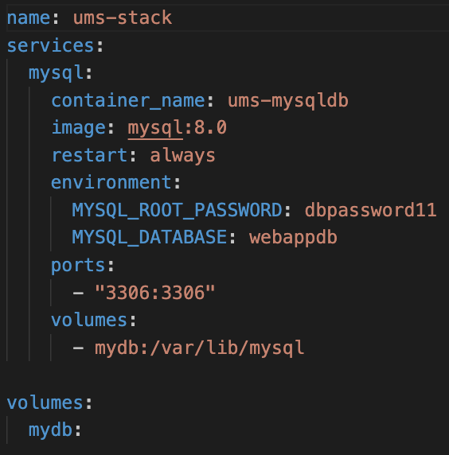
Docker Compose - Basics
Compose File
Deploy MySQL 8.0 using Docker Compose in ums-stack
Persist database data with a named volume mydb
Expose port 3306 to enable external database connections
Set up MySQL environment variables for root password and initial database (webappdb)
Enable automatic restarts with restart: always to ensure high availability

Slide 85
Demo-25
Docker Compose Named Volumes

Slide 86
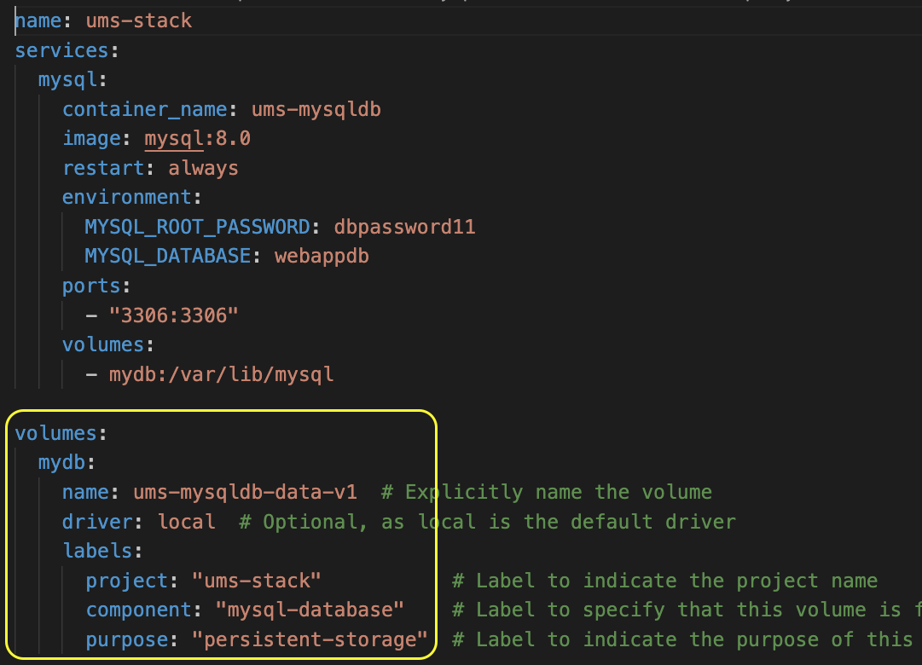
Docker Compose - Named Volumes
Compose File
Explicitly name the volume as ums-mysqldb-data-v1 for clear identification
Use volume labels for better management
Set volume driver to local (optional, as it's the default)

Slide 87
Demo-26
Docker Compose UMS Stack

Slide 88
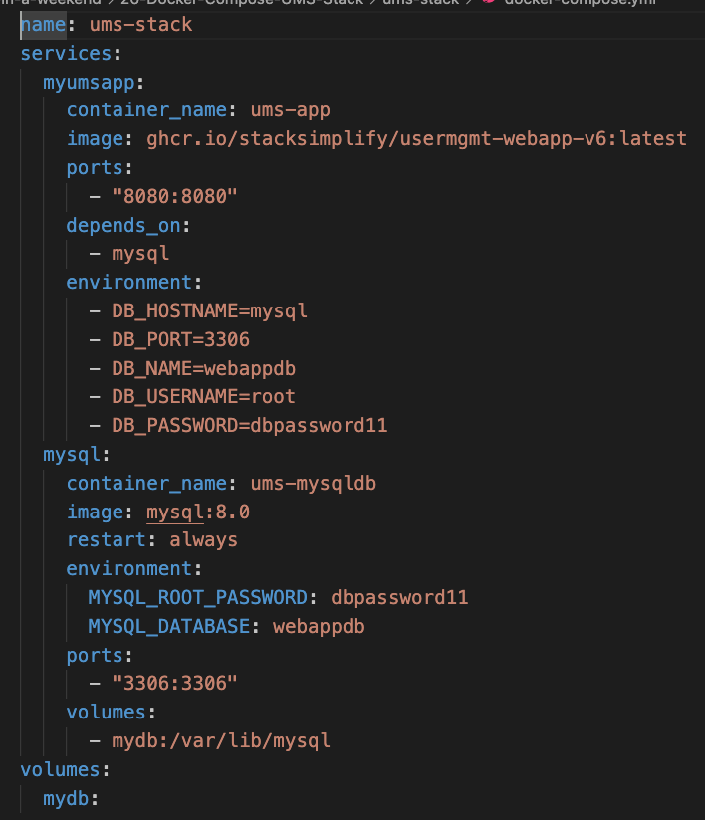
Docker Compose: UMS Stack
Compose File
User Management Web Application
(UMS)
MySQL
Service: myumsapp
Service: mysql
Docker Compose Stack: ums-stack

Slide 89
Docker Compose: UMS Stack
Compose File
Deploy user management web app and MySQL with Docker Compose (ums-stack)
Facilitate inter-service communication via environment variables
Connect from UMS webapp to MySQL DB
Ensure proper startup order with depends_on directive
Depends On: mysql service to ensure the database starts first
Expose necessary ports for external access to services
Expose port 8080 for web application access
Expose port 3306 for database access

Slide 90
Demo-27
Docker Compose DEPLOY - Scale Replicas
3 Tier Deployment
Nginx -> UMS Web App -> MySQL DB

Slide 91
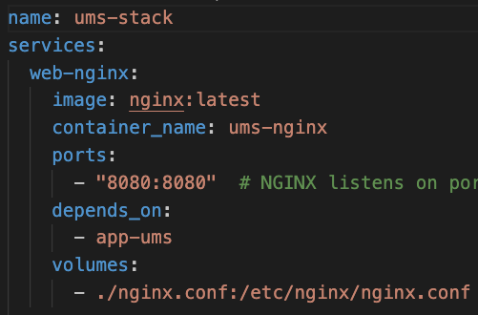
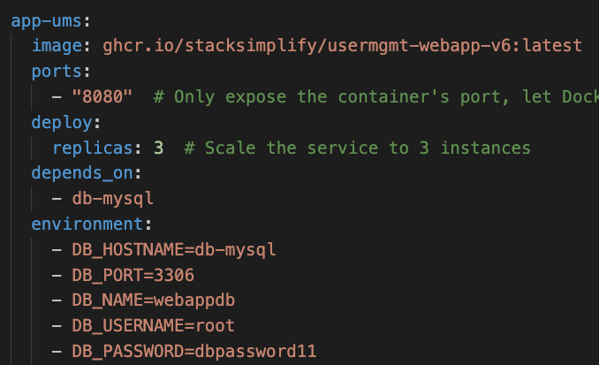
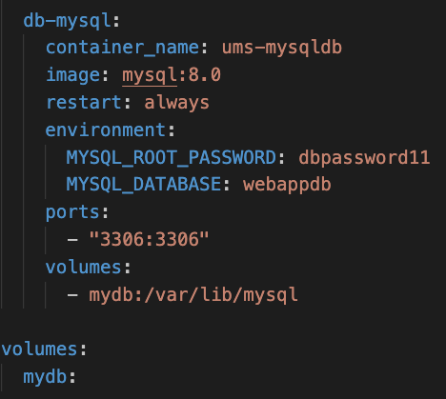
Docker Compose: DEPLOY
Web Tier
App Tier
DB Tier
Nginx Web Server
User Management Web Application
MySQL Database

Slide 92
Demo-28
Docker Compose NETWORKS
(Frontend and Backend Networks)
3-Tier Deployment
Nginx -> UMS Web App -> MySQL DB

Slide 93
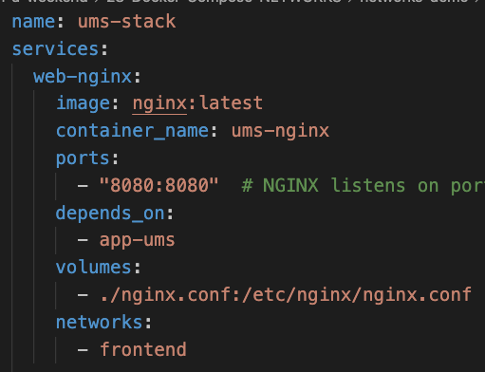
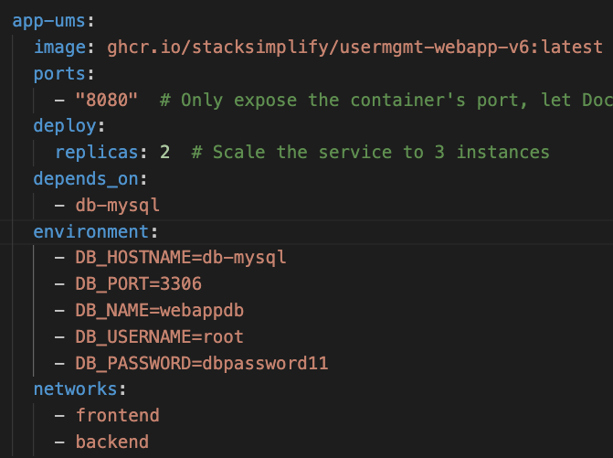
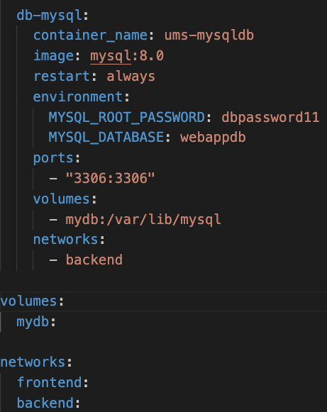
Docker Compose: NETWORKS
Web Tier
App Tier
DB Tier
Nginx Web Server
User Management Web Application
MySQL Database

Slide 94
Demo-29
Docker Compose HEALTHCHECKS
(Frontend and Backend Networks)
3-Tier Deployment
Nginx -> UMS Web App -> MySQL DB

Slide 95
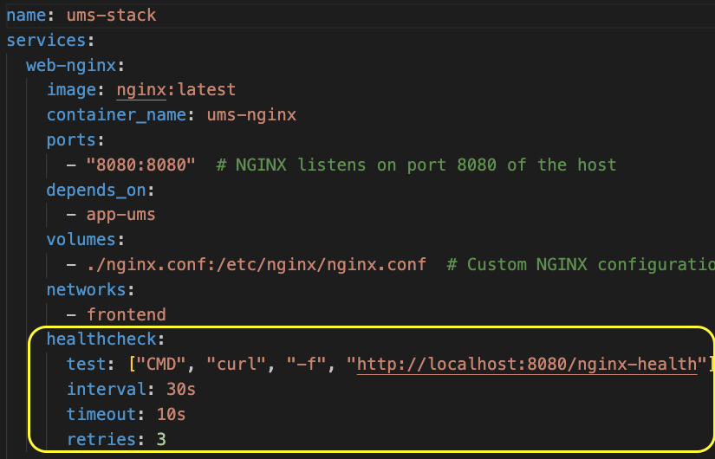
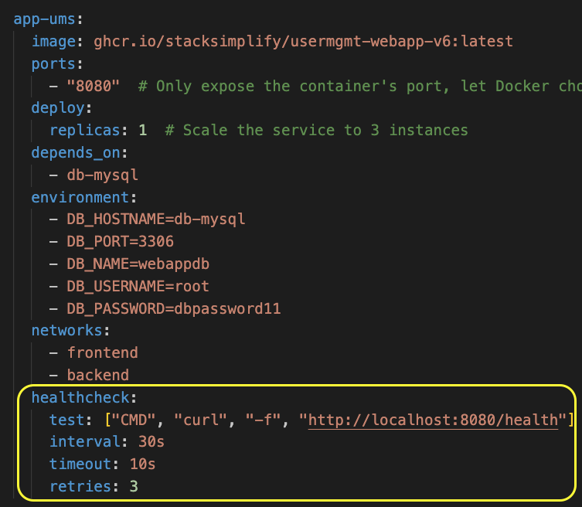
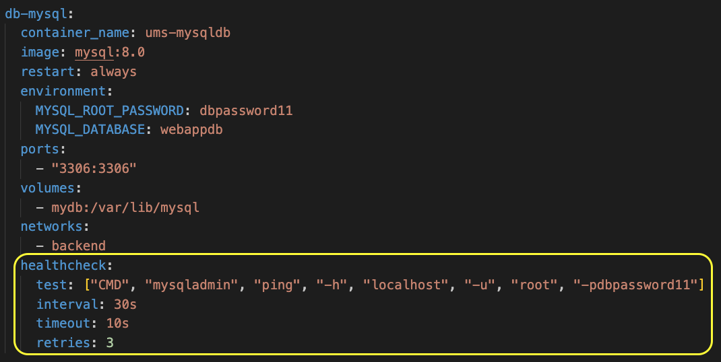
Docker Compose: HEALTHCHECK
Web Tier
App Tier
DB Tier
Nginx Web Server
User Management Web Application
MySQL Database

Slide 96
Demo-30
Docker Compose STARTUP ORDER WITH CONDITION
(Frontend and Backend Networks)
3-Tier Deployment
Nginx -> UMS Web App -> MySQL DB

Slide 97
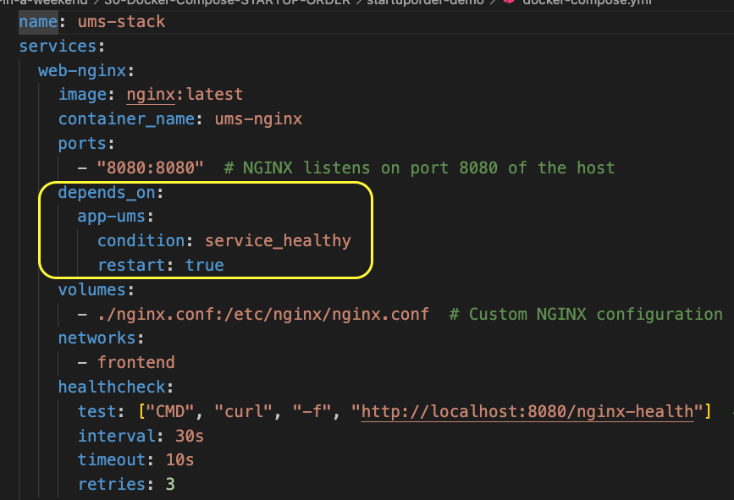
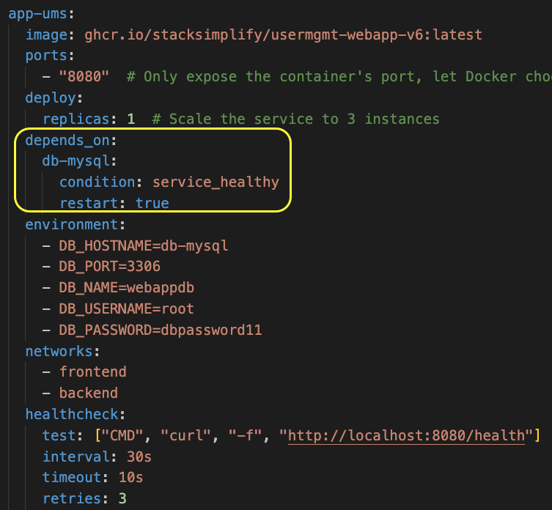
Docker Compose: STARTUP ORDER
Web Tier
App Tier
DB Tier
Nginx Web Server
(Starts only if UMS is healthy)
User Management Web Application
(Starts only if MySQLDB is healthy)
MySQL Database

Slide 98
Demo-31
Docker Compose PROFILES
3-Tier Deployment
Nginx -> UMS Web App -> MySQL DB

Slide 99
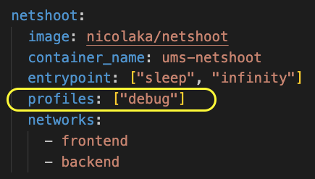
Docker Compose: Profiles
Part of compose file
Docker Compose Profiles: Customizing services for different environments
Selective Service Activation
Use profiles to enable or disable specific services based on your environment or use case.
Service Assignment
Assign services to profiles; unassigned services run by default.
Profile-assigned services start only when their profile is activated.
Flexible Configuration
Include optional services (e.g., for debugging or development) in a single docker-compose.yml.
Activate these services as needed without modifying the Compose file.
How to use profiles?
# Start Service with the 'debug' Profile
docker compose --profile debug up –d
# Stop and Remove Service with the 'debug' Profile
docker compose --profile debug down

Slide 100
Demo-32
Docker Compose LINKS
3-Tier Deployment
Nginx -> UMS Web App -> MySQL DB

Slide 101
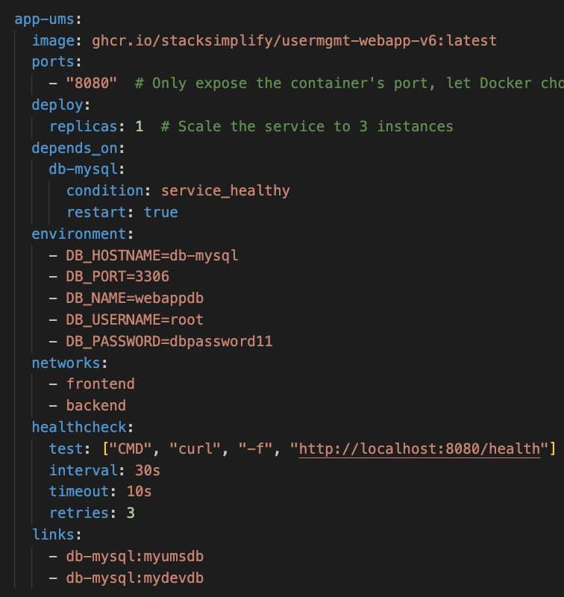
Docker Compose: LINKS
Part of compose file
Default Networking behaviour:
When you run services using Docker Compose, it automatically creates a default network for your application.
All services are connected to this network and can reach each other using their service names as hostnames.
Communication without Links:
You do not need to specify links for one service to communicate with another.
For example, a service named web can access a service named db simply by using the hostname db.
Purpose of Links:
The links option is used only to create additional aliases or hostnames for a service.
It does not enable communication; it provides alternative names by which a service can be reached from another service.
In the following example, db-mysql is reachable from app-ums at the hostnames
myumsdb, mydevdb
IMPORTANT NOTE: LINKS is old technology; ALIASES is latest now (will be discussed in next demo)

Slide 102
Demo-33
Docker Compose ALIASES
3-Tier Deployment
Nginx -> UMS Web App -> MySQL DB

Slide 103

Docker Compose: ALIASES
Part of compose file
Aliases declares alternative hostnames for the service on the network.
Other containers on the same network can use either the service name or an alias to connect to one of the service's containers.
Aliases are network-scoped, the same service can have different aliases on different networks.

Slide 104
Demo-34
Docker Compose --build flag

Slide 105

Docker Compose: --build
Purpose of --build:
Forces Docker Compose to rebuild images defined in your docker-compose.yml before starting containers.
When to Use:
After making changes to the Dockerfile.
When application code or dependencies have been updated.
To ensure containers run the latest version of your image.
Command Syntax:
docker compose up --build -d
Combines building and starting containers in one step.
compose file

Slide 106
Demo-35
Docker Compose --watch flag, sync, sync + restart

Slide 107

Docker Compose: --watch, sync, sync + restart
--watch Flag:
Docker compose watch (--watch flag) enhances the development workflow
Real-Time Code Synchronization (sync):
Automatically sync changes to your code or static files into running containers without rebuilding images.
Enables instant feedback and faster iteration during development.
Example: Nginx Static Content
Automatic Container Restart (sync + restart):
Containers can automatically restart when configuration files change.
Ensures that updates requiring a restart are applied immediately without manual intervention.
Example: Nginx config file changes
Simplified Command:
Use docker compose up --watch to enable the Develop Watch feature.
Combines starting containers with active monitoring for changes.
compose file

Slide 108
Demo-36
Docker Compose --watch flag, sync, rebuild

Slide 109

Docker Compose: --watch, rebuild
Automatic Docker Image Rebuild (rebuild):
Automatically rebuild Docker images when changes happen to specific monitored configuration files.
Example: Nginx config file changes
compose file

Slide 110
Demo-37
Docker BuildKit Buildx CLI

Slide 111


Docker BuildKit
Docker Build Architecture:
Buildx (Client): The command-line interface (CLI) tool used to run and manage Docker builds.
BuildKit (Server): The backend builder that executes the build processes.
Local Builders (On Local Desktop)
Remote Builders (Docker Build Cloud)
What is BuildKit?
An advanced build engine that replaces the legacy Docker builder.
Default Builder: As of Docker Engine version 23.0, BuildKit is the default builder.
Enhanced Performance: Offers improved build speed, efficiency, and new features.
Improved Build Performance:
Faster builds through parallel execution and optimized caching.
Reduced build times lead to increased productivity.
Dockerfile
Parallel Builds
Multi-platform Support
Cache Efficiency
Remote Builds
Secret Management
Enhanced Security
BuildKit
Docker Image

Slide 112

Docker BuildKit - Builders

Slide 113
Demo-38
Docker BuildKit Build Multi-platform
Docker Images

Slide 114
Build Multi-platform Docker Images
Multi-platform Docker images:
Build once, run anywhere approach for multiple architectures.
Simplifies deployment processes across diverse environments.
BuildKit and Buildx:
provide the tools necessary to build and manage these images efficiently.
Sample Platforms
arm64
amd64
amd64/v2
386 … and many more
Dockerfile
Parallel Builds
Multi-platform Support
Cache Efficiency
Remote Builds
Secret Management
Enhanced Security
BuildKit
arm64
amd64
Docker Image

Slide 115

Build Multi-platform Docker Images

Slide 116
Demo-39
Docker Build Cloud Cloud Builder

Slide 117
Docker Build Cloud
What is Docker Build Cloud?
A cloud-based build service for Docker images provides scalable, remote infrastructure to handle builds, especially for resource-intensive or multi-platform projects.
Scalable Infrastructure
Unlike local builds constrained by your machine’s resources, Docker Build Cloud provides
scalable resources
speeding up builds
allowing for concurrent operations on large projects.
Dockerfile
Parallel Builds
Multi-platform Support
Cache Efficiency
Remote Builds
Secret Management
Enhanced Security
Build Kit - Cloud Builder
arm64
amd64
Docker Image

Slide 118
Docker Build Cloud
Enhanced Multi-platform Support
Easily build images for multiple architectures (e.g., amd64, arm64) in one process, making it ideal for cross-platform deployments without setting up complex local environments.
Remote Build Caching
Reuse cached layers from previous builds stored in the cloud, reducing build times and resource usage, especially for frequently updated applications.
Improved Security and Secret Management
Securely manage sensitive data (e.g., secrets, API keys) directly in the cloud, ensuring it’s used only during the build process and never included in the final image.
Dockerfile
Parallel Builds
Multi-platform Support
Cache Efficiency
Remote Builds
Secret Management
Enhanced Security
Build Kit - Cloud Builder
arm64
amd64
Docker Image

Slide 119
Demo-40
Docker
Multi-stage Builds

Slide 120

Docker Multi-stage Builds
Dockerfile
Multi-Stage Build:
Multi-stage Dockerfile keeps the final image lightweight by avoiding build tools and development dependencies in the final stage.
Only production dependencies and necessary application code are included, reduces the image size and potential attack surface.
Lightweight Final Image:
Using node:bookworm-slim in the final stage further reduces the image size compared to the full node:bookworm image, making deployments faster and resource-efficient.
Improved Security:
By keeping only production dependencies and excluding unnecessary build files, this approach reduces the risk of vulnerabilities.
The smaller image size also makes it easier to audit and manage.

Slide 121
ANYTHING AFTER THIS SLIDE IS NON-LIVE SLIDES

